Slide 1
A project presentation review on
Black Friday Sales Data Analysis
BY
, Team Four Pies
Team Members:
M. Madhan
T. Madhava Krishna
D. C H N Phaneendra
P. Manoj

Slide 2
Introduction:-
The day after thanksgiving in the U.S. Is called black friday (BF) and serves as the traditional start to the holiday shopping season.
It is known for deep discounts (e.G., Doorbusters), black friday shopping manifests adventure, competition and urgency around getting great deals.
Although cyber monday is gaining popularity, black friday shopping continues to be popular because of an abundance of doorbuster deals, instant gratification, and the benefit of social shopping.

Slide 3
Objective:-
Predicting Purchase
Build a simple Machine Learning model that can predict how much a Customer is likely to spend on the eve of Black Friday.
Pattern Recognition
Reveal and Understand the most important factors from predictors such as Age, Gender, City of Residence etc., that influence the spending of a Customer.
Establish a quantitative impact of the revealed factors and how they influence Purchase by a Customer on a personal level i.e., whether they have a positive or negative contribution on the Purchase.

Slide 4
Dataset
Collection:-
The data comes from a competition hosted by Analytics Vidhya[2].
Description:-
The Dataset comprises of 550000 observations about the Black Friday in a retail store.
It contains various kinds of variables either Numeric or Categorical in nature. The dataset contains 2 columns with missing values:
166986 observations missing in column ‘Product_Category_2’.
373299 observations missing in column ‘Product_Category_3’.

Slide 5
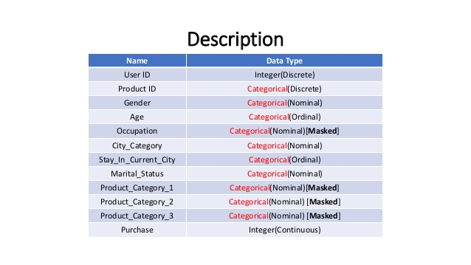
Discription of Variables

Slide 6
Pre-Processing:-
Most of the raw data contained in any given Dataset is usually unprocessed, incomplete, and noisy.
In order to be useful for data mining purposes, the Dataset needs to undergo pre-processing, in the form of ‘Data Cleaning’ and ‘Data Transformation’.
Handling Missing Values[3] .
Handling Outliers.

Slide 7
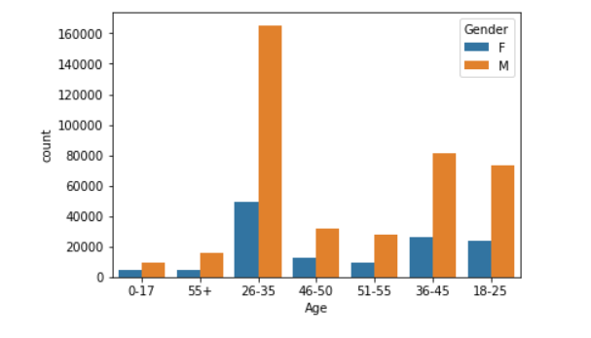
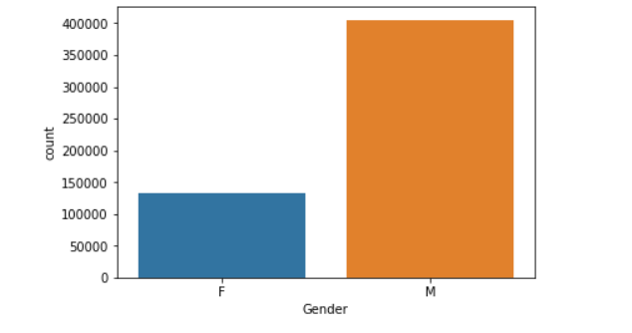
Exploring Categorical Variables
Male shoppers are more frequent than Female Shoppers.
Age bracket 18-45 shops the most.

Slide 8
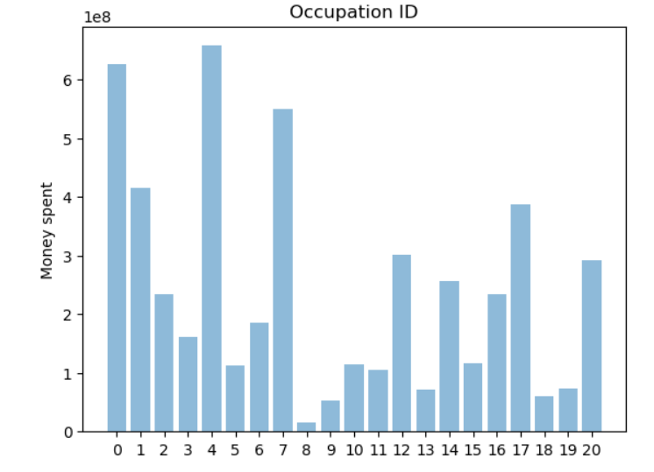
Exploring Categorical Variables
Top 5 Customers by Purchase: 4, 0,7,1,17
Lowest 5 Customers by Purchase: 19,13,18,9,8

Slide 9
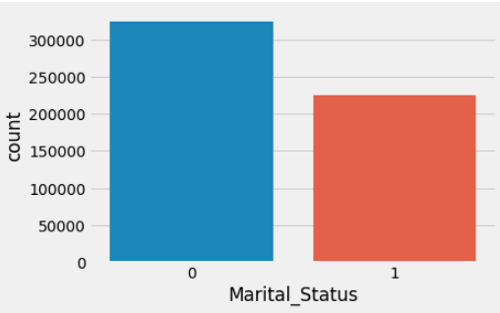
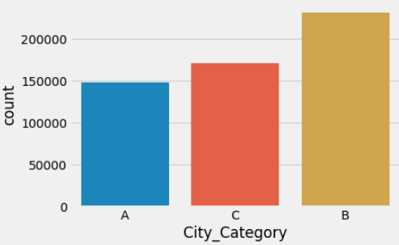
Distribution of the variables

Slide 10
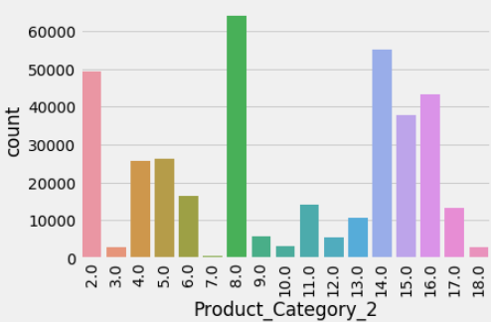
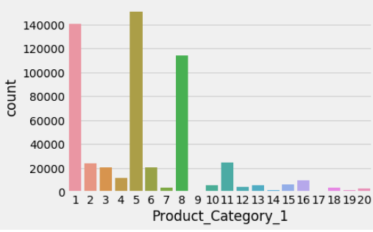
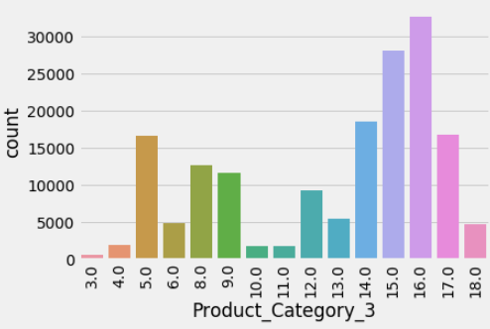
Distribution of the Numeric variables

Slide 11
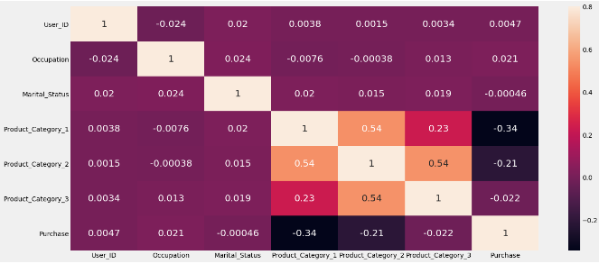
Correlation

Slide 12
Model Fitting
We have applied different kind of the classification on our data and selected the one which gave us the best accuracy
Linear rigression: 12.4907%
Decision tree : 41.3729%
Random forest : 66.5594%
Conclusion :-
Here random forest is the one which gave the best accuracy. Having an
Accuracy of 66%(test) & 94%(train) means that our model is good enough to predict whether the customer would like to purchase or not.

Slide 13
Top HasTags:-
#BlackFriday 114K
#GivingTuesday 79K
#CyberMonday 63K

Slide 14


